Slide 1

EMPLOYEE MANAGEMENT SYSTEM
By Team Pseudo Mavericks

Slide 2
Project description
Our application's major purpose is to provide users with an online interface for the Employee Management System.
In general, an organization can utilize our application to manage employee information, with admin users having the ability to create users, assign projects, and approve user requests. Employees can submit requests such as leave requests, timesheet submissions, and payslips downloads on monthly basis.
Everyone can access our app, but in order to view their information, they must first have an account, and only admin users can create accounts for employee users. If he or she is already a user, they can use their login credentials to access the website.
Our app has several sections, including leave management, timesheet submissions, and payslips generation.

Slide 3
System Overview
Employee Management Software allows the company to organize its staff and record on an individual level.
There are HR and employee users in the system.
Employees can view their profile, access pay slips, report billing hours, apply leaves and view project hierarchy.
Additionally, HR users can track employees, approve leaves and assign employees to projects.

Slide 4
Development plan for phases
Phase 1:
Login and Registration
Create Database for project
Dashboard of employees and menu
Phase 2:
HR user features for project management and employee management
Leave Management and Timesheet submission
SQL procedures for project
Phase 3:
Build Payroll module
Generate pay slips for employees
System Testing and Integration Testing

Slide 5
Team members responsibilities
Amarendhar Reddy Chevula: HR admin register, Employee Creation, Submit leave requests (HR & Employee), payslip template
Subbarao Sanka: HR admin index, Billing hours screens(HR & Billing), Authentication, Payroll management.
Vaishnavi Choppalli: HR admin login, Project Management, Employee login screen, Billing submission request.
Narasimha Gurram: Employee management for HRs. Asserts. Unit testing.
Kalyani Virivinti: Leave management for both HR & Employees.
Aparna Mirapakayala: Logout sections for both HR & Employees. Javascript.
Neha Chowdary Puvvada: Database management for HR & Employees.
Kavya Keerthi Thumarada: My Profile section for both employees and HR and testscripts.

Slide 6
Requirements(core functionalities)
Login:
HR Users: HR users can log in to the application by switching to the HR login screen.
Employee Users: Employee users can log in to the application by switching to the employee login screen.
Employee Creation:
This panel is restricted to HR users only, here HR can create new users for the application.
Project Management:
This panel is also restricted to HR users, using this HR can create new projects into the application and assign employees to the projects based on the requirements.
Send Payslips:
This panel is also restricted to HR users, using this HR can send emails to the employees in the organization with the payslips as an attachment.

Slide 7
My Profile:
Using this section, users can update their information like Phone number and email. Also, users can update their passwords here.
Billing Management:
Employee billing management: Employees can submit their timesheets to HR. Also, can view the status of the requests.
HR Billing Management: Once the user sends the request, HR can accept or reject their requests and view each request’s status.
Leave Management:
Employee leave management: Employees can submit their leave requests to HR.
HR leave management: Once the user sends the request, HR can accept or reject their requests and view the status of the requests.
Payroll Management:
Employee’s payroll management: Employees can download the payslips in the payroll management panel.
HR payroll management: HR can send payslips to employees.

Slide 8
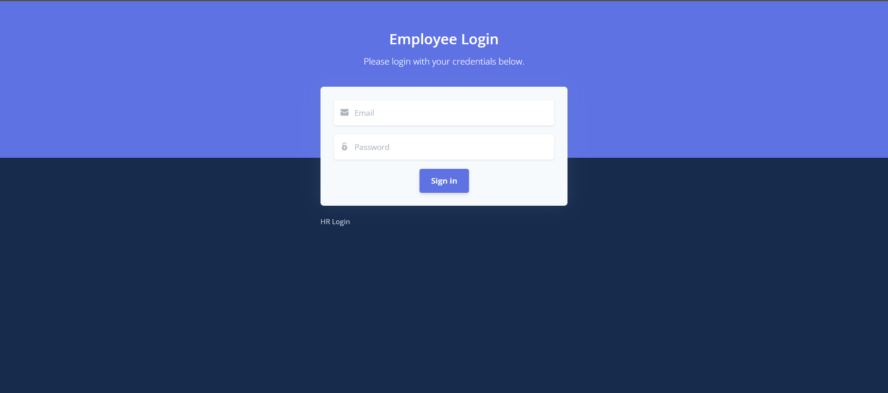
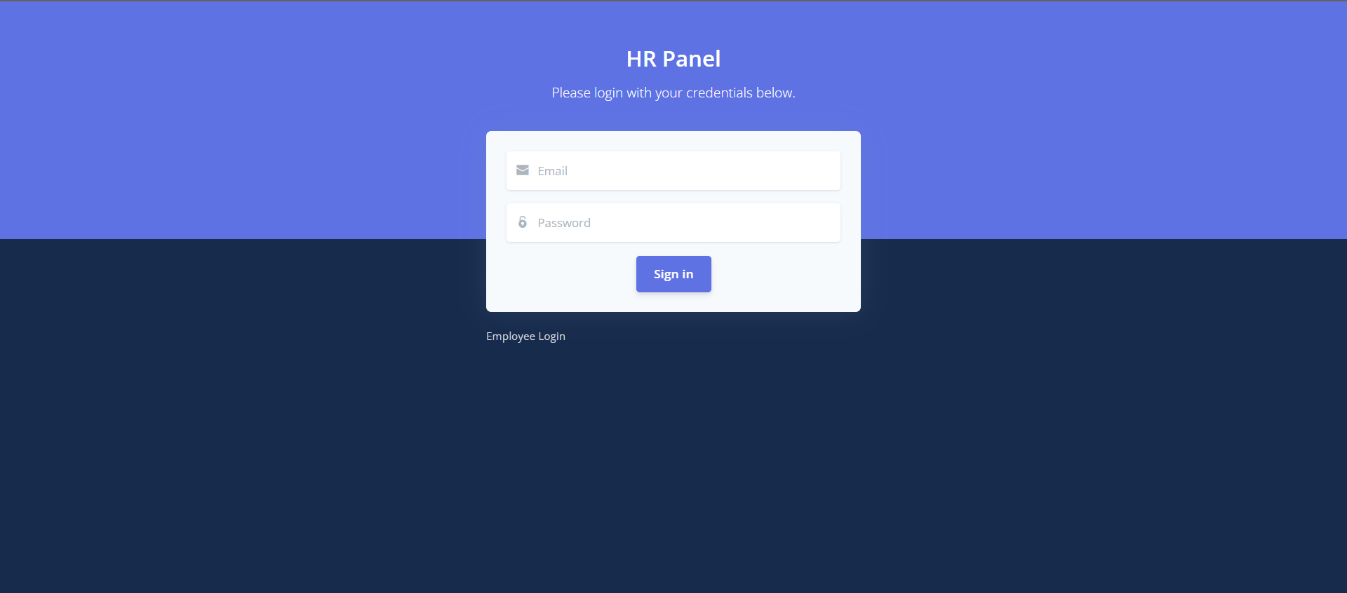
HR and Employee login screens
HR and employees are having different login screens.

Slide 9
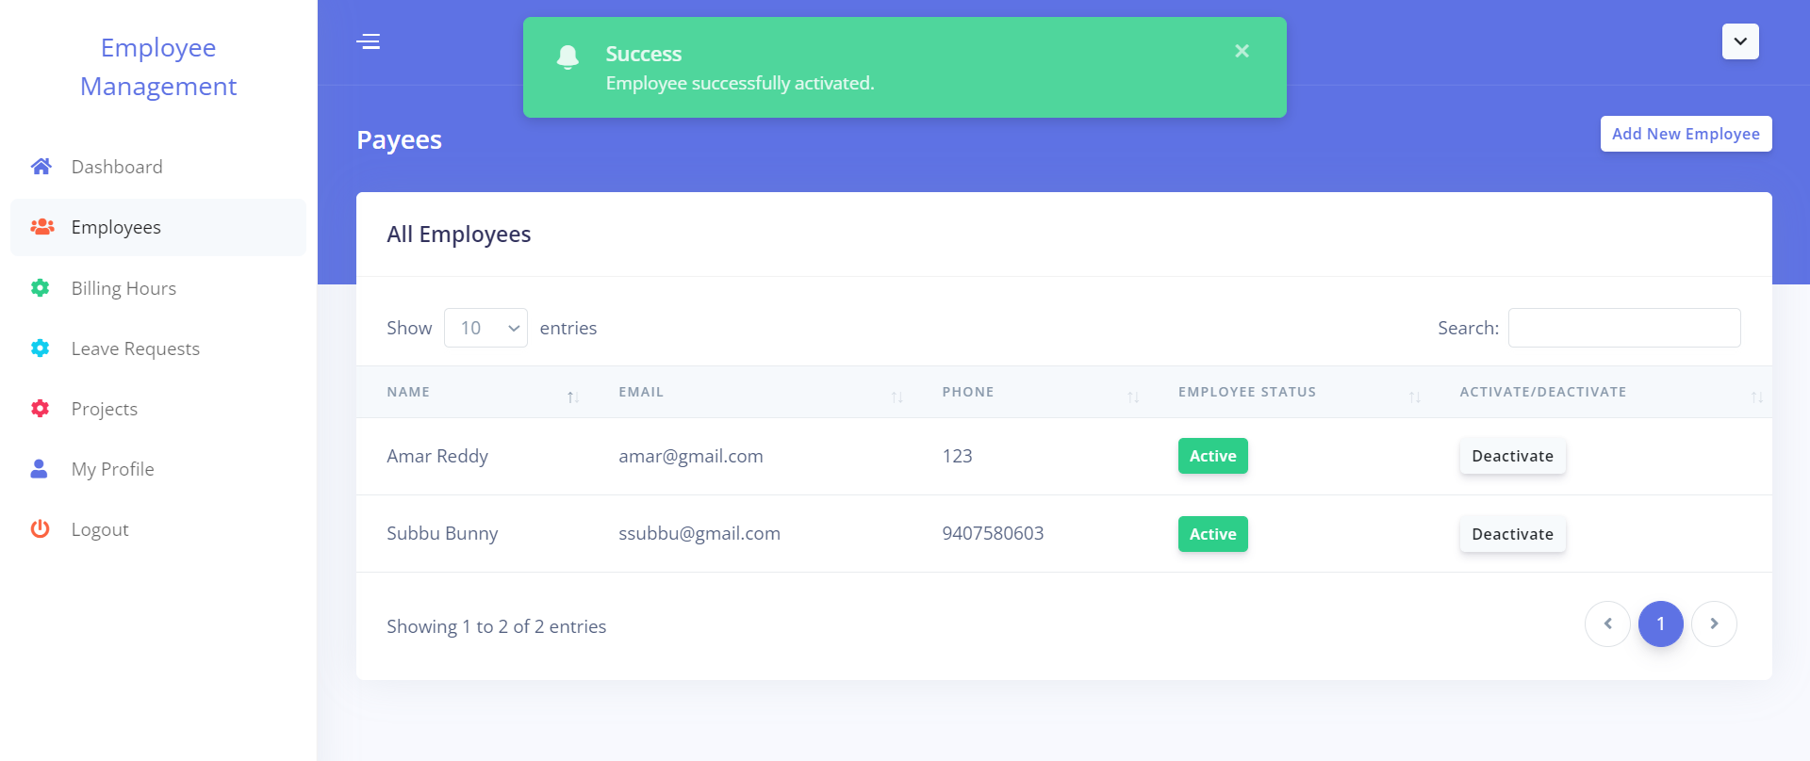
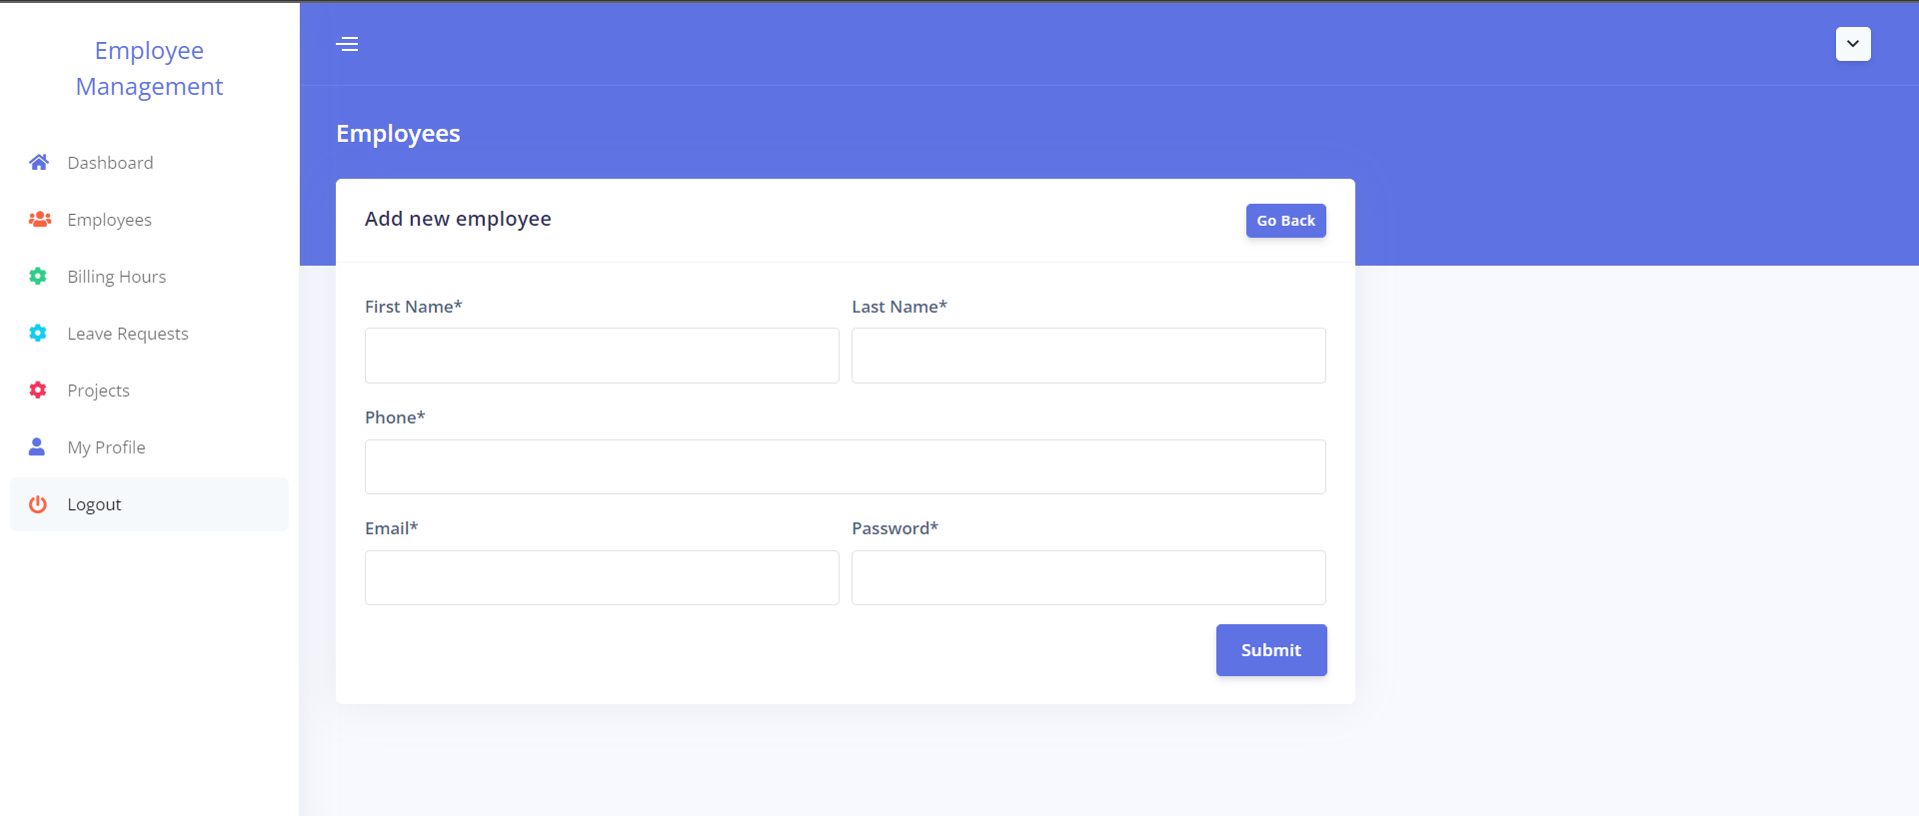
Employees
This panel is used to create new employees and view existing employees in the organization, which can be restricted to HR users only. HR can also activate and deactivate the changes.

Slide 10
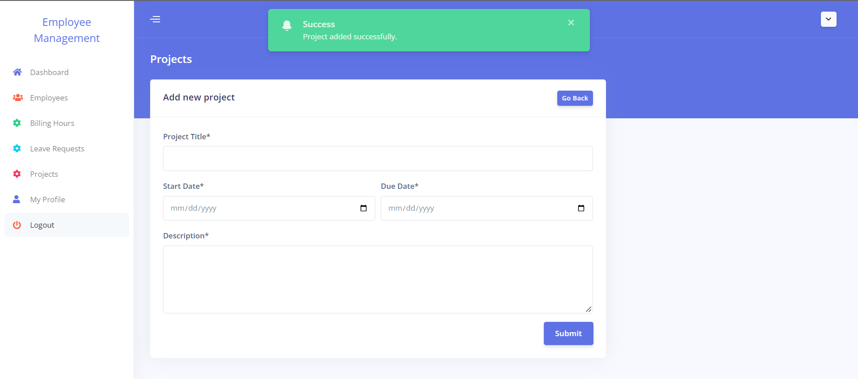
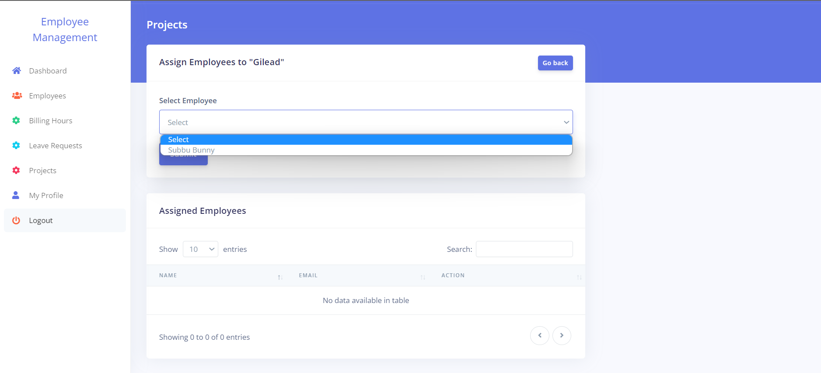
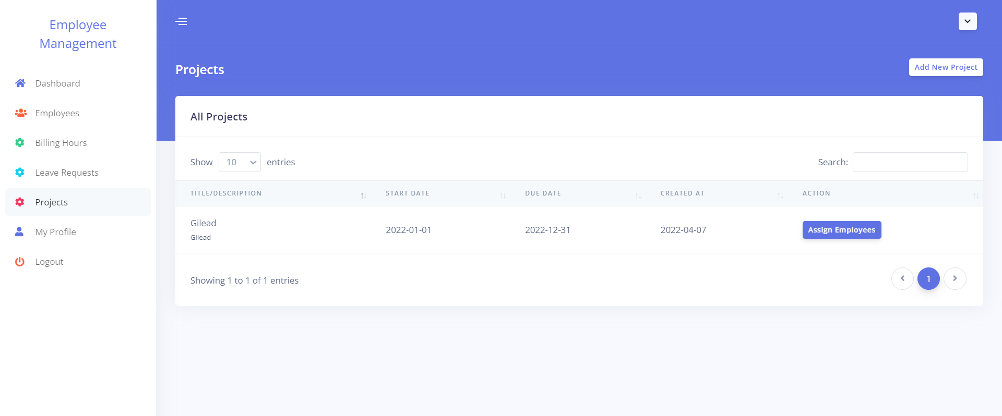
Projects
Only HR users have access to the projects panel, which is used to create projects, allocate employees, and project hierarchy.

Slide 11
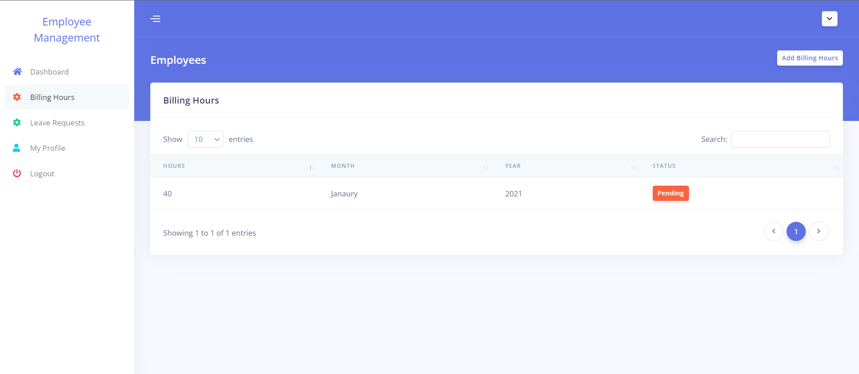
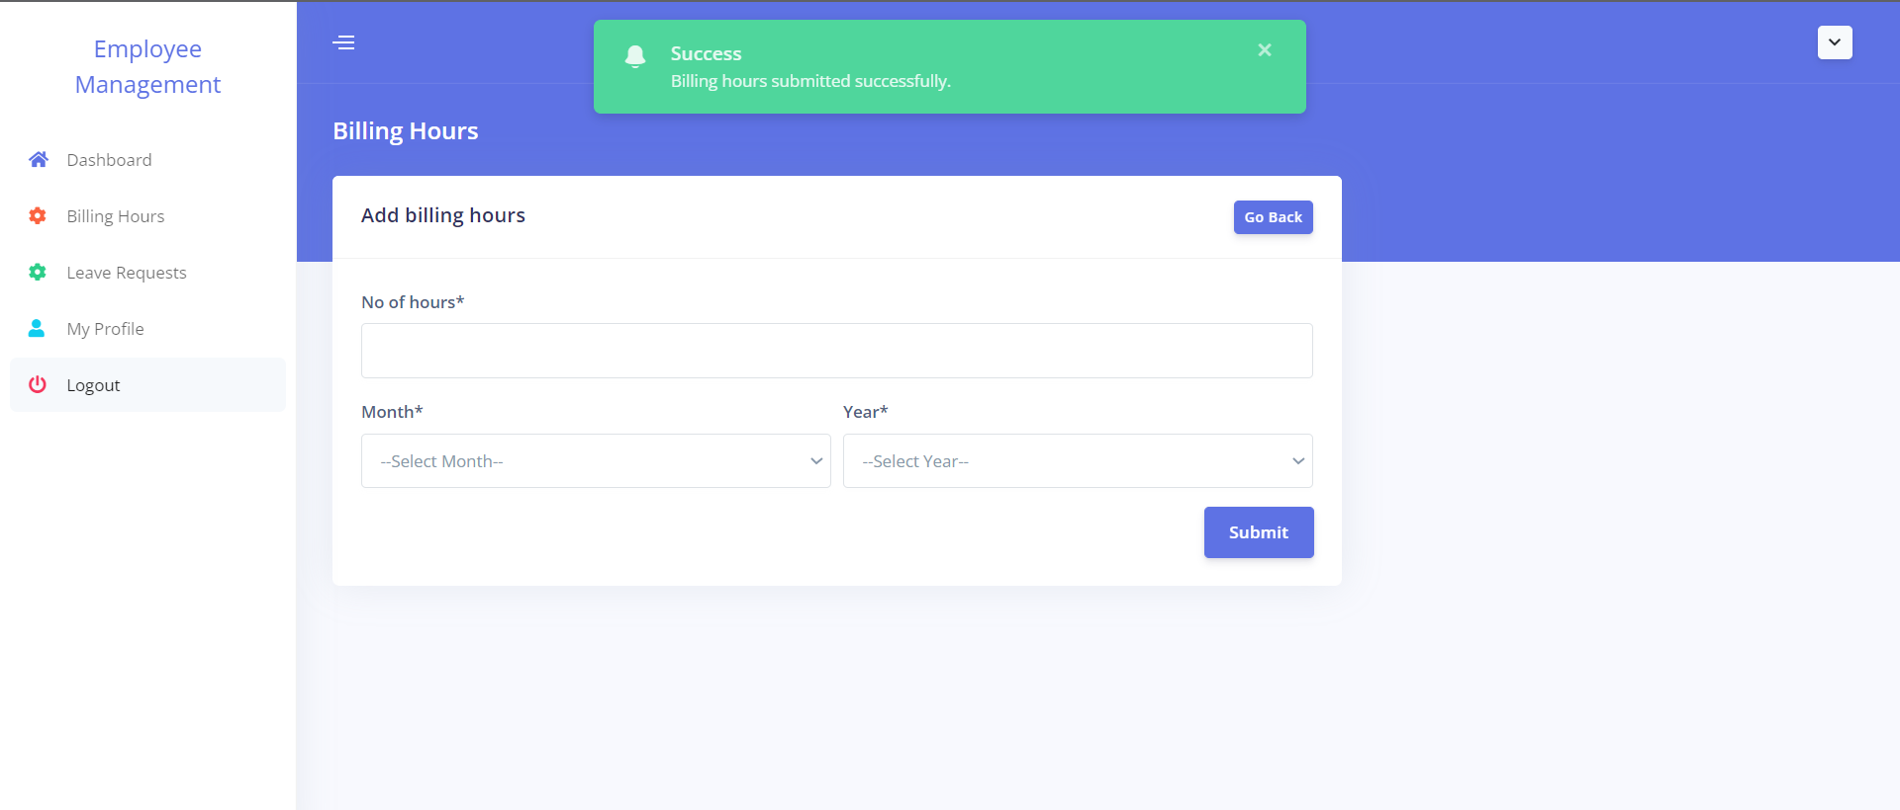
Billing Hours panel for employees
This is where the billing hours are created and submitted. They can also see a list of billing hours and their current status.
Once employees submit their billing hours, the request will be sent to HR.

Slide 12
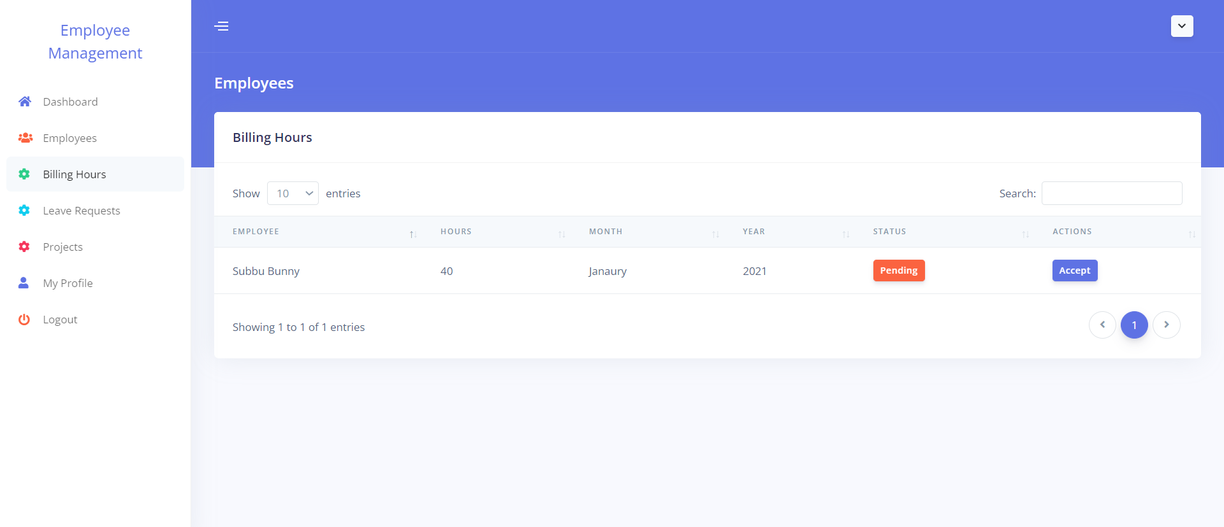
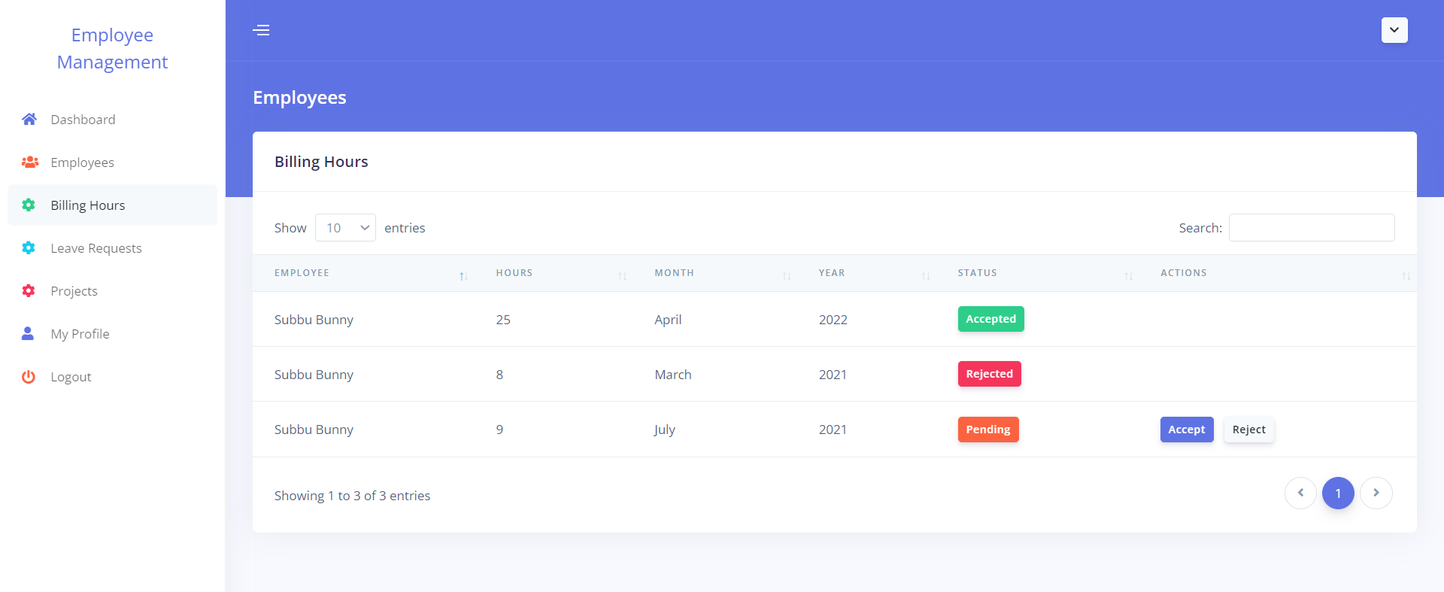
Billing hours panel for HR
HR can approve the billing requests submitted by employees and can view the status of the requests. HR can also accept or reject the employee’s request.

Slide 13
Leave Hours panel for employees
This is where the employee can create and submit timesheets. Also, can view the list of leave requests and their current status.
Once employees submit their leave requests, the request will be sent to HR.

Slide 14
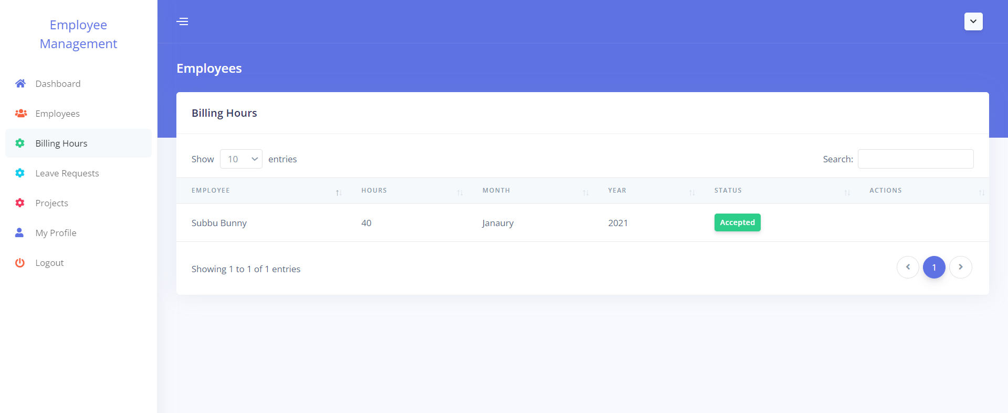
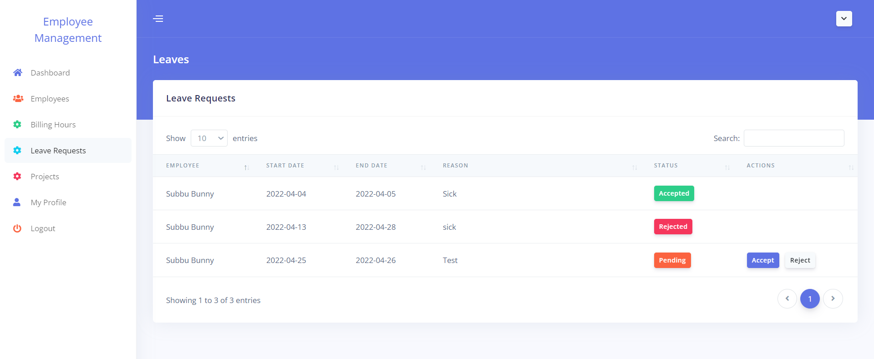
Leave Hours panel for HR
HR can approve the leave requests submitted by employees and can view the status of the requests. HR can also accept or reject the employee’s request.

Slide 15
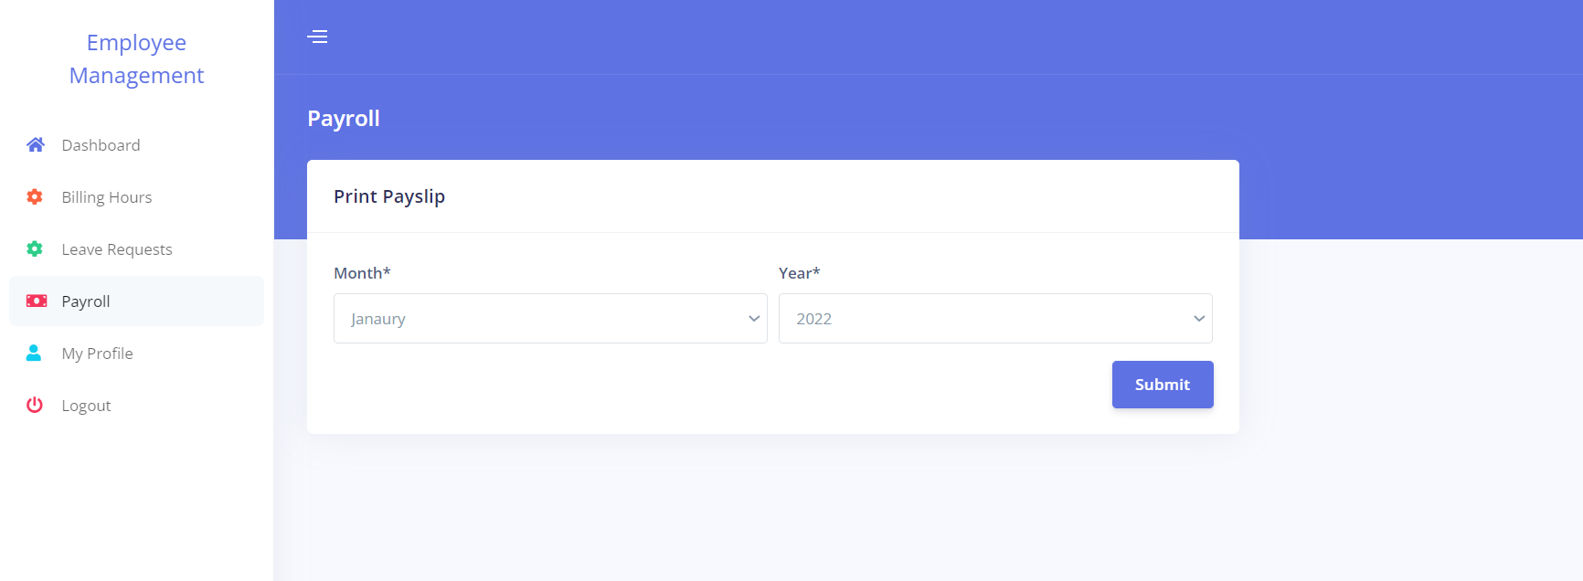
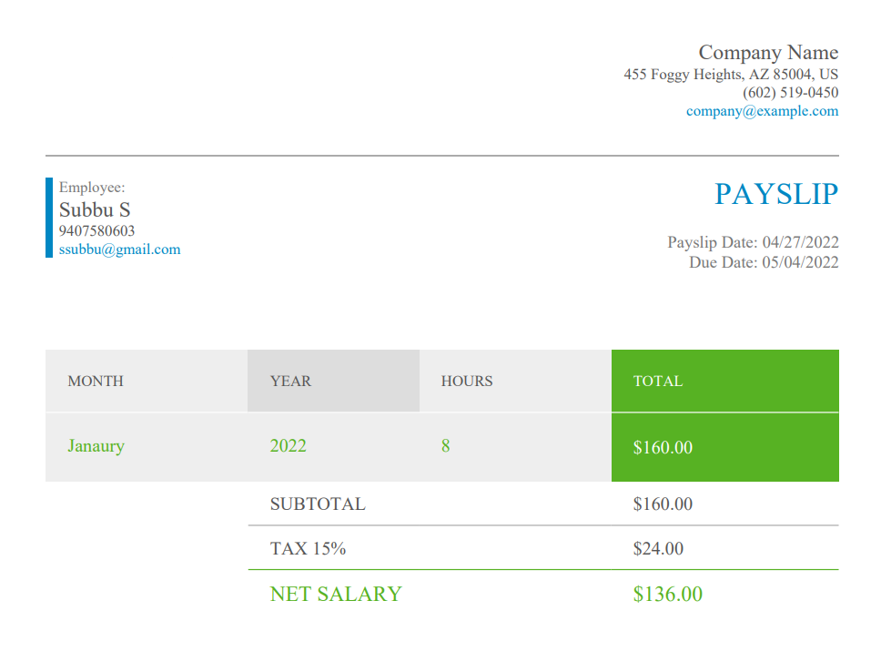
Payroll management
Employees can download their payslips. Attached is the sample payslip

Slide 16
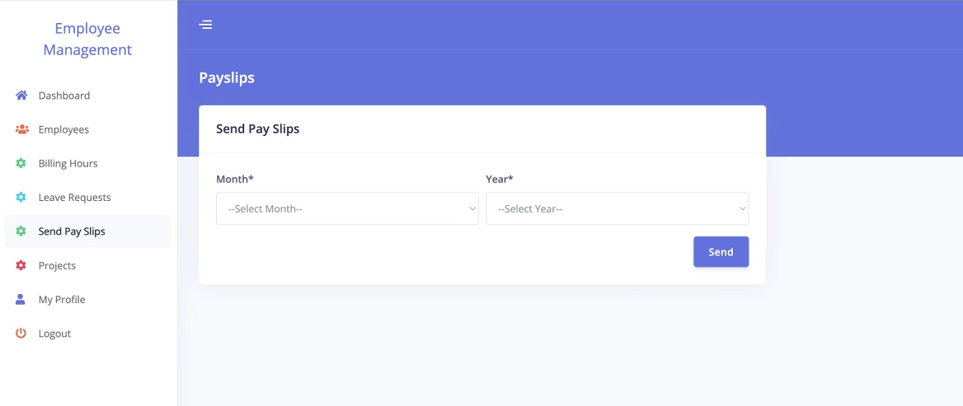
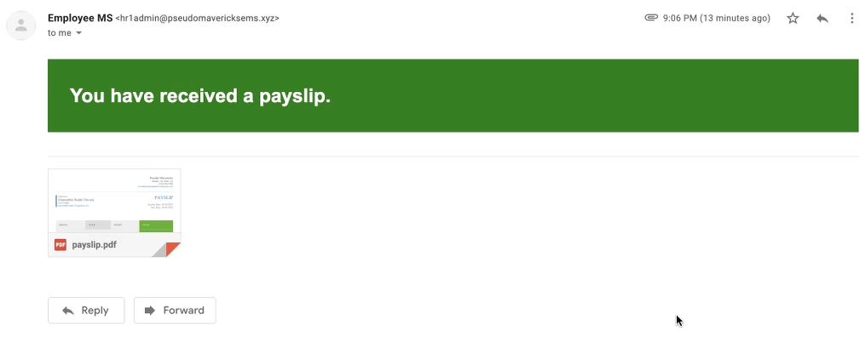
Send pay slips
This panel is restricted to only HR. using this HR can generate and send payslips to employees through emails.

Slide 17
Project implementation minimum requirements
The list of instructions to run the project in their local/computer, the minimum requirements should be:
System specifications
Minimum of intel 5th generation or higher.
RAM: minimum of 4 GB.
Around 5GB of hard disk storage.
To construct the application, the user must first install an IDE (Integrated Development Environment). We prefer Eclipse or NetBeans.
Import the project repository into the IDE and configure the PHP connection.
On the local PC, install the PHP libraries.
Additionally, they must set up a XAMPP server on their PC.
After installation, they need to start the Apache server, MySQL database admin control panels using XAMPP.
After launching, it will navigate the phpMyAdmin console page, where we need to create a database according to the connection file in the project.
After the database has been created, we need to import the SQL file to the database from the appropriate folder location.
Then the user can access the application using their localhost URL.

Slide 18
Project implementation instructions
Download the project zip file.
Can use GitHub to clone the repository using the below URL.
https://github.com/amarendhar-reddy/project-pseudo-mavericks.git
Extract the zip file.
Place the extracted files in XAMPP's htdocs folder.
In the IDE, create a workspace and import the project folder into it.
Configure the PHP to the workspace using the instructions below.
On the toolbar, go to the preferences area beneath the window section.
Select the Installed PHPs under the PHP section.
Add the name and PHP executable file.
Create a database in phpMyAdmin with the name “employee_ms”.
In the database, import the "employee_ms.sql" file.
To start as admin, set up the start page in the IDE's run configurations.
/employee_ms/login.php
Run the application and access the application using the localhost URL.
Ex: http://localhost/employee_ms/login.php#!
To run the test cases, we need to configure the PHPUnit in the IDE.
Navigate to the run configurations, Add the PHPUnit properties.
After adding it, run the application as a PHP unit test.

Slide 19

Platform & languages used
PHP
JavaScript
CSS
HTML
Xampp (Local server)
MySQL
C Panel (Web server)
PHPUnit

Slide 20
Unit testing & Functional testing experience
As part of phases 1& 2, we have identified a few bugs in the application, which we resolved in phase3.
With the help of integration testing, We were able to identify the issues considerably early. As a result, we are able to deploy our application on schedule.
We were able to verify each and every feature that had been intended as part of the initial design through system testing.

Slide 21
Feedback from peer reviews
During the peer evaluation review, our team went through the features and codebase and suggested adding a new feature where we will save the customer login status in the browser session.
With the login status being stored in the browser session we can enhance the security of the user information by redirecting to the login page if someone alters the login status or Man-in-the-Browser attack. We have discussed and decided to include this feature in our project.
Also, adding the employee status is suggested; if an employee has been terminated from the organization, he or she should not be able to access the website.

Slide 22
Code inspection results
During the Code inspection session, the opposite team went through the features and codebase and suggested updating a feature such as the Authorization user component as it is not properly specified so we decided to add authorization as a requirement for our application.
The team also suggested adding the Author details for the coding part, so we even updated it in the source code as well.

Slide 23
Limitations faced during the project
We planned for auto-generation payslips at the end of every month under the project plan, however, we were unable to accomplish so owing to time constraints. As it requires, cron jobs must be auto-scheduled at the end of each month to generate payslips and sent to staff emails. In addition, we decided to add a new feature for HR to generate and send payslips to employees via emails.
We faced a few challenges within the team in our initial days, a few members were not familiar with the technologies.

Slide 24
THANK YOU

